Slide 1
Introduction to Economics BSIT 5th semester
Topic: Elasticity of demand
Teacher name: Fizza shaukat
Lecture 2

Slide 2


Elasticity and slope
Elasticity measures the relative response of quantity to changes in price.
Elasticity is a measure of a variable's sensitivity to a change in another variable
Elasticity of demand is calculated as the percentage change in quantity demand divided by the percentage change in price. Mathematically it can be expressed as:
Slope measures the steepness or flatness of a line in terms of the measurement units for price and quantity.
Slope can be represented mathematically as:
slope = change in y/change in x
Slope(x) = rise/run.

Slide 3
Elasticity of Demand
Following are the elasticity’s of demand:
The price elasticity,
The income elasticity,
The cross-elasticity of demand.

Slide 4
Price Elasticity of Demand
Price Elasticity of Demand refers to the responsiveness of quantity demanded to a change in price. The quantity demand of any product can be elastic or inelastic, depending on the rate of change in the demand with respect to the change in the price.
Price Elasticity of Demand is the slope of the demand curve. We can calculate the slope as “rise over run”. When the slope of the demand curve is steeper, it means demand changes at a slower rate, which shows a less elastic demand. Conversely, the flatter demand curve shows a much greater quantity demanded response to a price change

Slide 5
Types of price elasticity of demand
We can identify if price elasticity of demand is elastic or inelastic from the result calculated by the price elasticity of demand formula. It is divided in five types;
Relatively elastic (EP ˃ 1)
Relatively inelastic (EP ˂ 1)
Unitary elastic (EP=1)
Perfectly elastic (EP = ∞)
Perfectly inelastic (EP = 0)

Slide 6
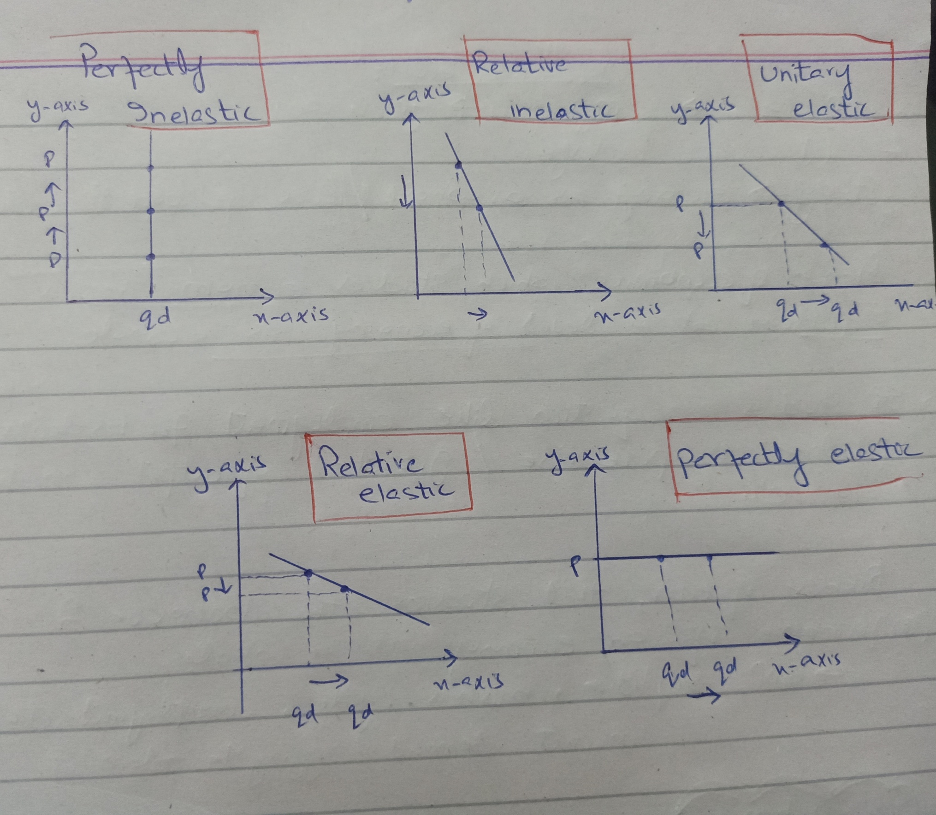

Slide 7
Measurement of Elasticity of demand
There are two types of demand regarding product:
Point estimation
Arc estimation

Slide 8

Point estimation
Point estimation is the ratio of percentage change in quantity demanded of a product to percentage change in its price estimated at a specific point on the demand curve instead of showing a line.
Point elasticity basically a very small amount of change in demand is measured by the change in price.

Slide 9

Arc estimation:
It measures the responsiveness of quantity demanded to a price.
Arc elasticity basically a considerable change in price and quantity demand that appears to another point on the demand curve that is somewhat away from the initial point, in this way, the elasticity of demand that is attained over the arc of the demand curve between the two points is known as arc elasticity of demand.
The arc elasticity method of elasticity calculation is also called mid-point method.

Slide 10
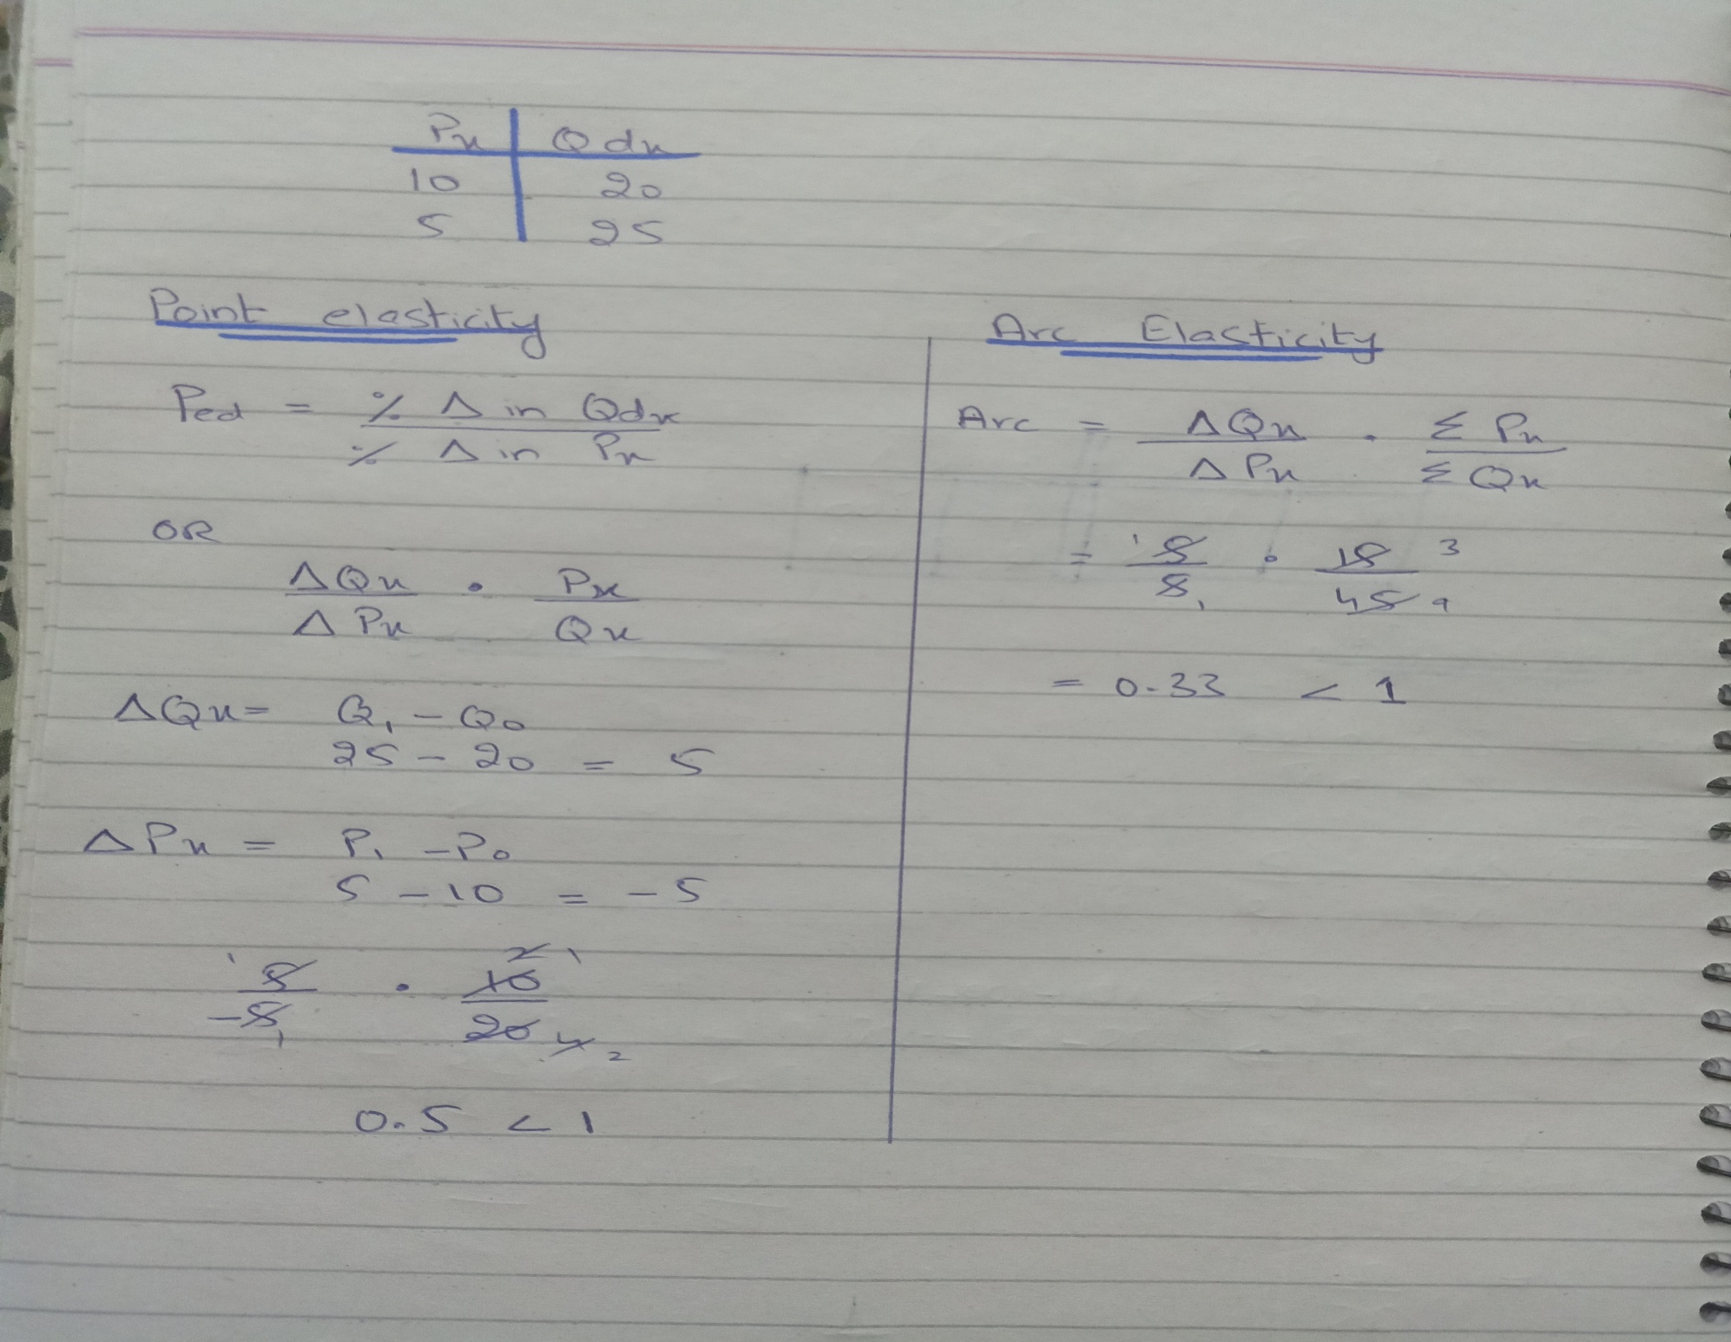

Slide 11
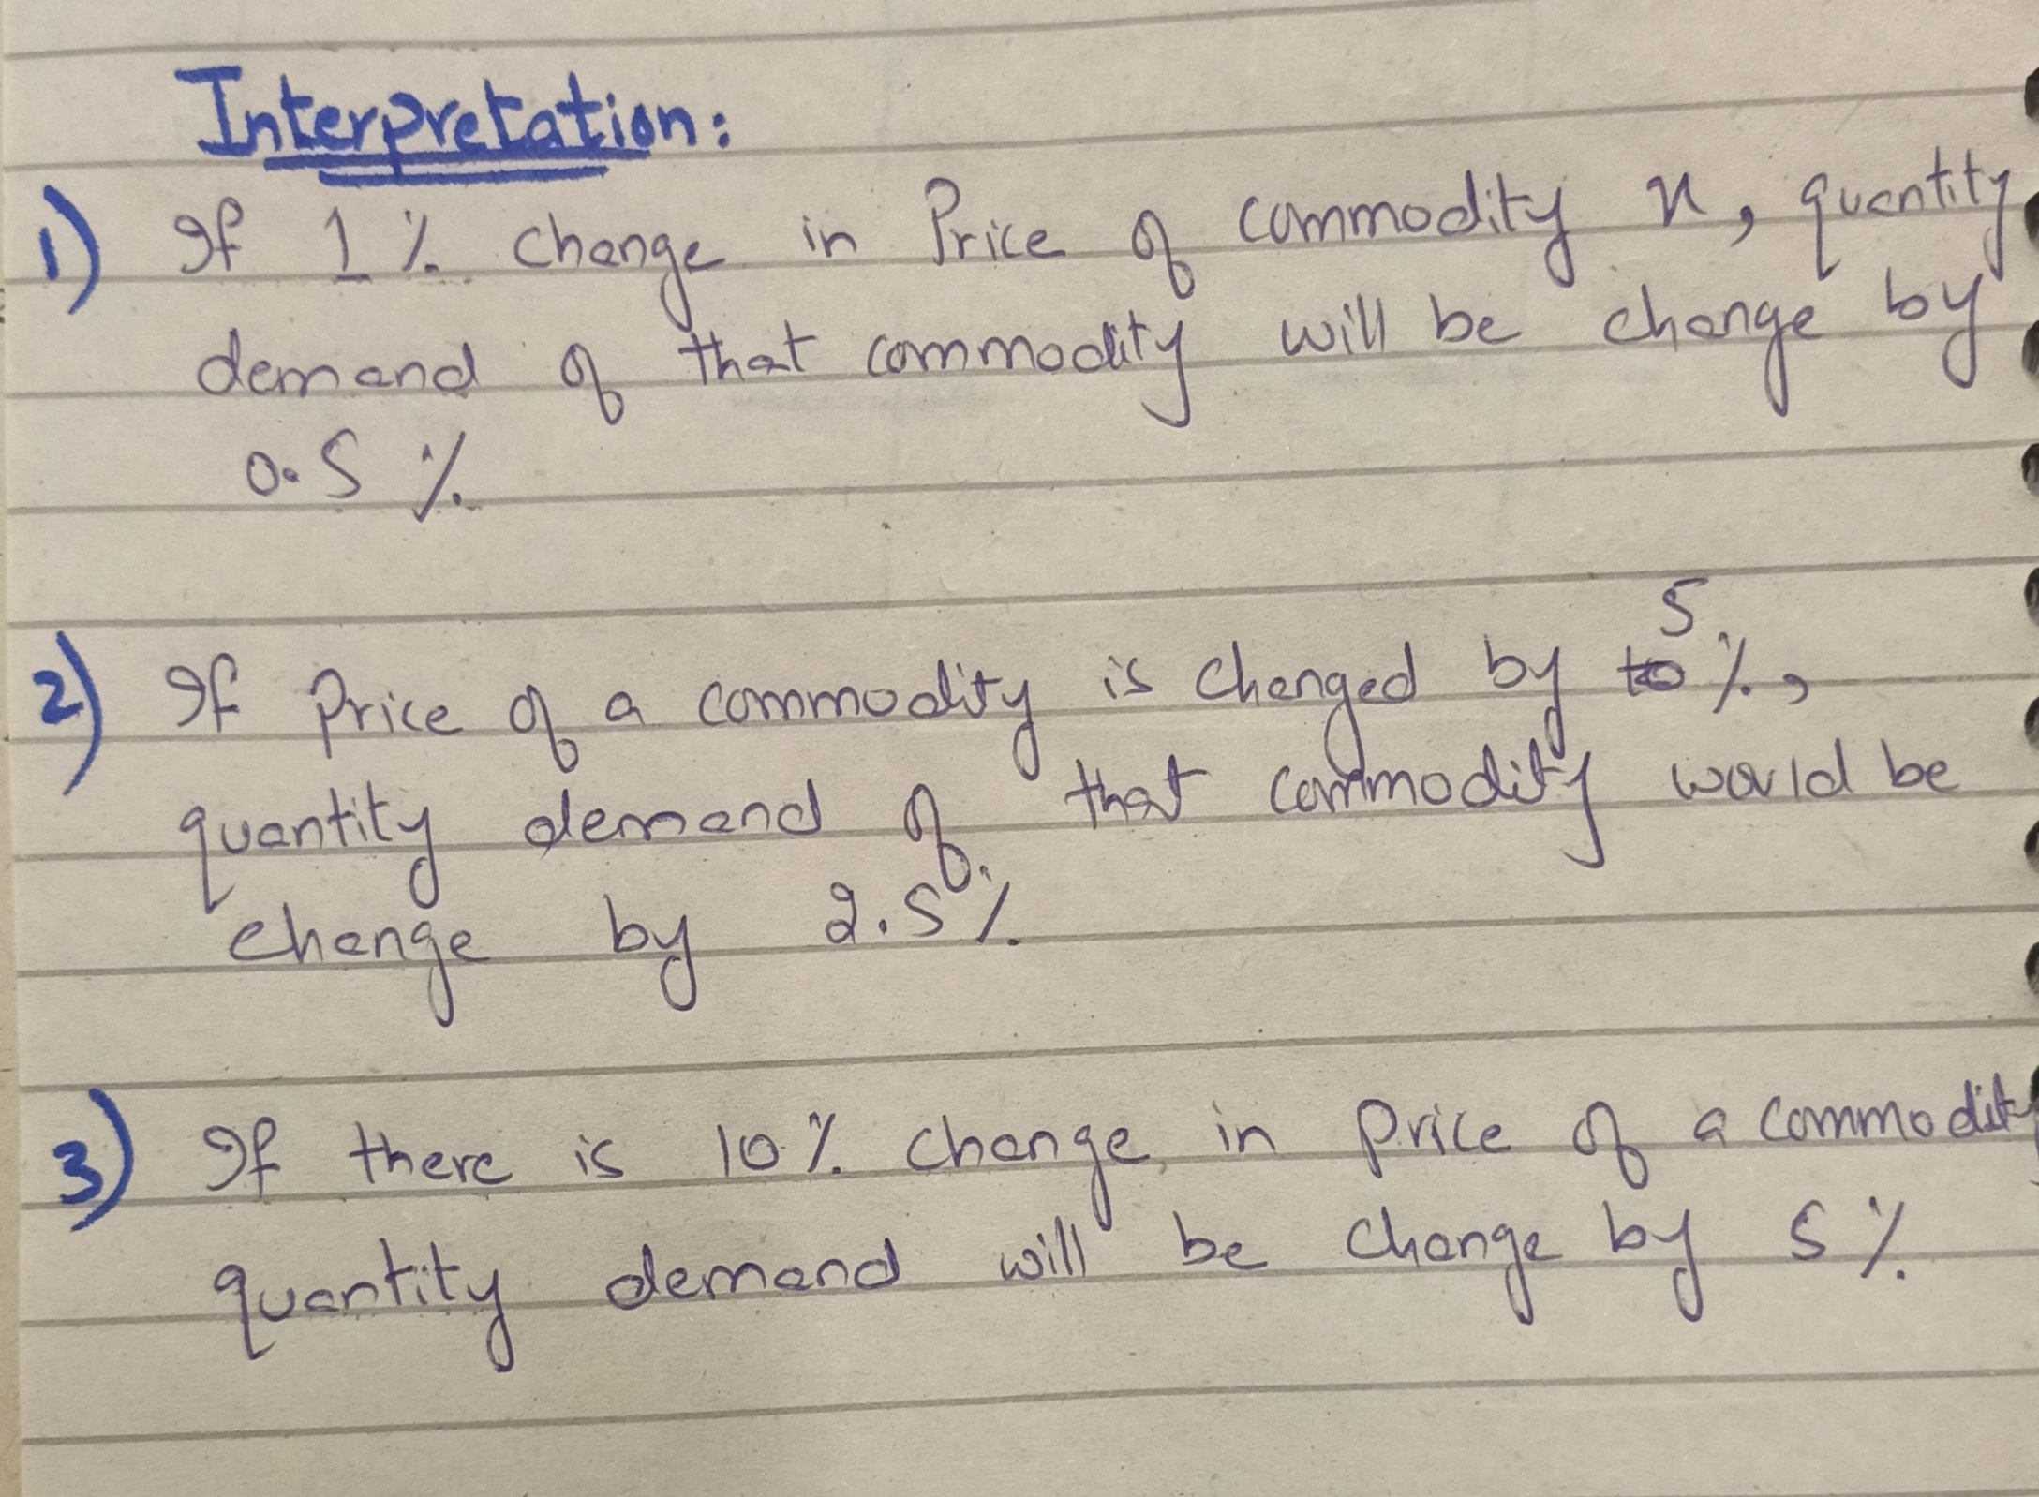

Slide 12
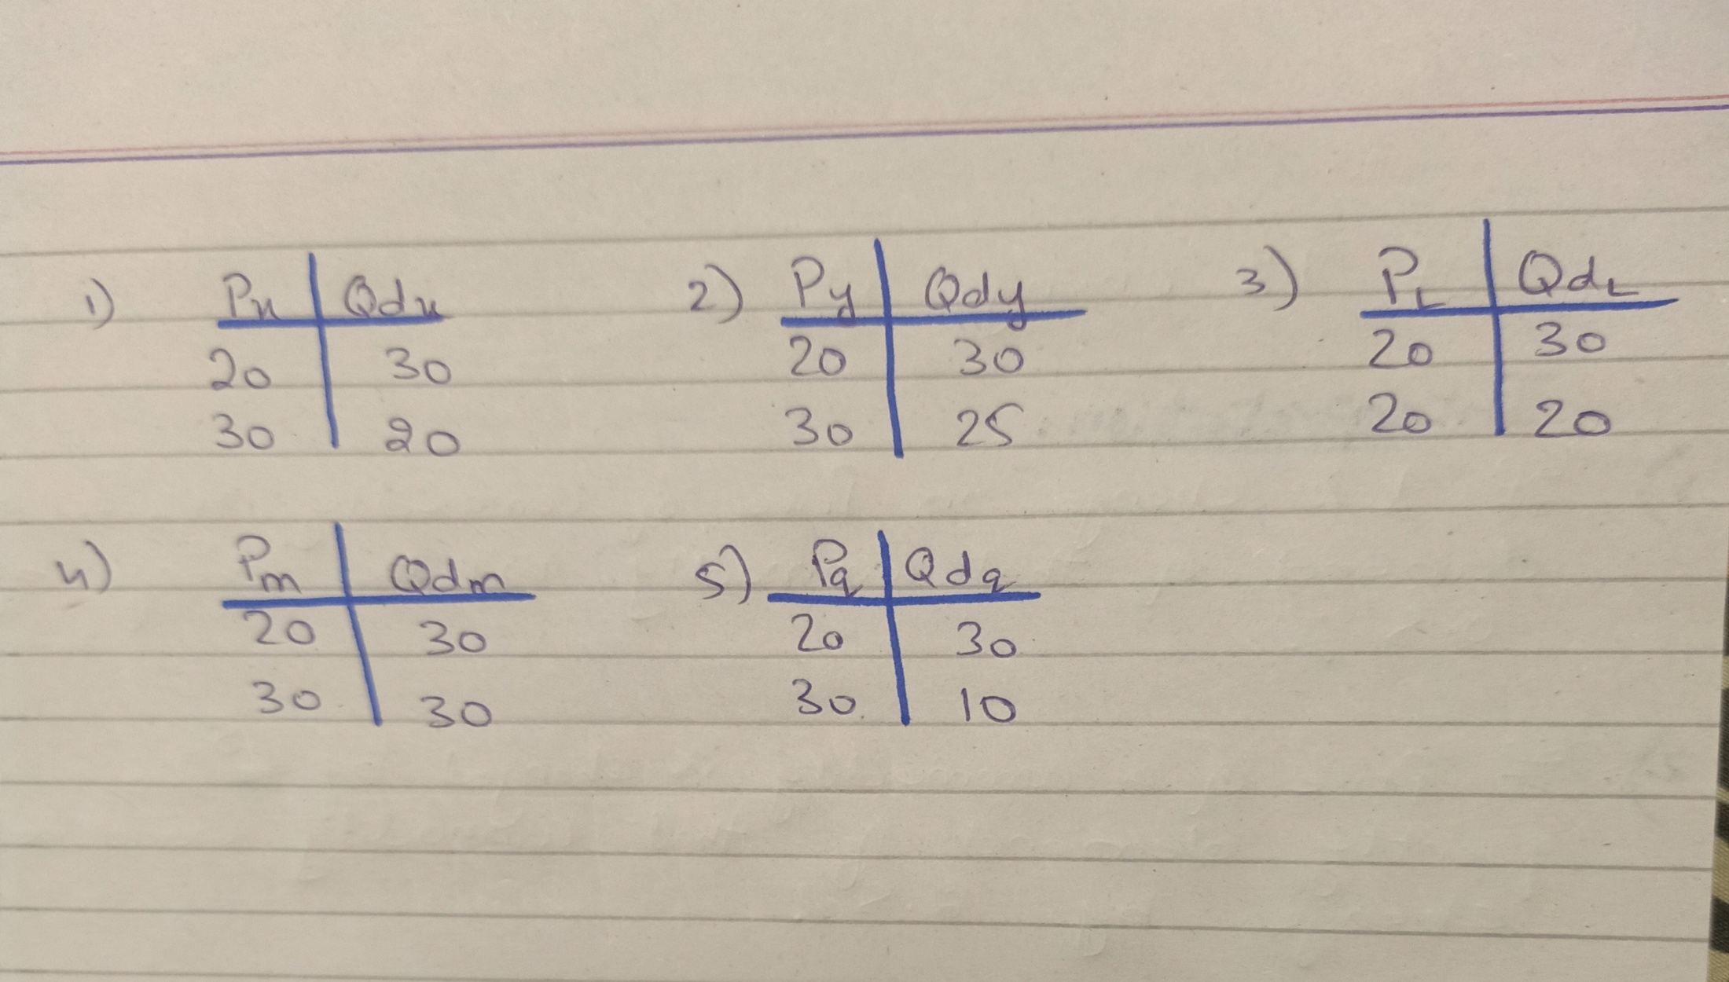
Practice question(solve with arc estimation)

Slide 13
Factor affecting Elasticity of demand:
Nature of product:
Availability of substitute:
Level of Income:
Price Level:
Habit, custom and fashion etc

